Slide 1
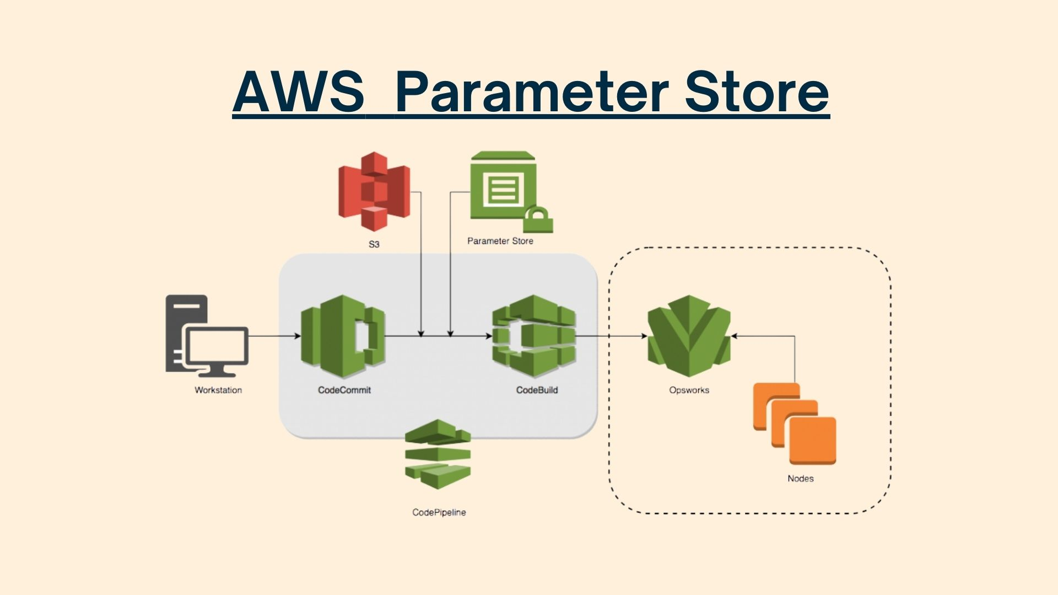
Topic on:-
Presented By:-
Sai varun Reddy
Batch - 15

Slide 2
What is Parameter Store?
Definition: Parameter Store is a feature of AWS Systems Manager that provides secure, hierarchical storage for configuration data management and secrets management.
Key Use Case: Store data such as passwords, database strings, AMI IDs, and license codes as parameter values that can be referenced by your applications and AWS resources.
Analogy: Think of it as a centralized, secure vault for your application settings and sensitive data.
Why Use Parameter Store? (Problem Solved)
Old Way: Hardcoding secrets/configs in code, storing them in configuration files, or using environment variables (less secure, difficult to update).
Parameter Store Solves This By:
Separation of Concerns: Decoupling configuration data/secrets from code.
Centralized Management: A single source of truth for all parameters.
Security: Encryption for sensitive data.

Slide 3
Parameter Types
String: Stores plain text data (e.g., a service URL, database name).
StringList: Stores a comma-separated list of values.
SecureString: Stores sensitive data, encrypted using an AWS Key Management Service (KMS) key.
Hierarchical Organization
Use a slash (/) separated naming convention to create logical groups (e.g., /dev/myapp/database-url, /prod/myapp/api-key).
Benefit: Allows for easy organization and retrieval of parameters by path (e.g., get all parameters under /prod/myapp).
Security and Access Control
Encryption: SecureString uses AWS KMS for encryption/decryption.
IAM Integration: Use AWS IAM policies for fine-grained access control to specific parameters or hierarchies.
Auditability: All API calls (gets, puts, deletes) are logged in AWS CloudTrail.
Versioning and Notifications
Versioning: Parameter Store automatically keeps a history of parameter values, allowing you to track changes and easily revert to a previous version.
Notifications: Integrate with Amazon EventBridge to trigger actions (like a Lambda function) or notifications when a parameter value is changed.

Slide 4
Core Benefits
Improved Security: No more plain-text secrets in code or configuration files.
Simplicity and Consistency: Centralized management across different applications and environments (dev, test, prod).
Reduced Operational Overhead: Update configuration once without deploying new code.
Cost-Effective: Standard parameters are free of charge.
Standard vs. Advanced Parameters
Standard: Free, up to 10,000 parameters, 4 KB maximum value size.
Advanced: Paid (small monthly charge), up to 100,000 parameters, 8 KB maximum value size, includes Parameter Policies (e.g., expiration).

Slide 5
Advantages of Parameter Store (Compared to Secrets Manager)
Cost: The Standard tier is completely free for storage and standard API throughput (up to 10,000 parameters). Secrets Manager is a paid service.
Versatility: It is ideal for storing both encrypted secrets (SecureString) and routine application configuration data (String, StringList).
Hierarchical Organization: It natively supports an easy-to-manage folder-like structure using paths (e.g., /app/prod/db-url).
Integration: It is a core component of AWS Systems Manager, simplifying its integration with other SSM features like Run Command and Automation.
Simple Parameter Policies: Advanced Parameters offer simple policies like setting an expiration (Time-to-Live or TTL) for configuration parameters.
Disadvantages of Parameter Store (Compared to Secrets Manager)
No Built-in Auto-Rotation: It lacks native, automatic rotation capabilities for secrets (e.g., database credentials). Custom Lambda functions are required for rotation.
Smaller Size Limit: Parameter values are limited to 4 KB (Standard) or 8 KB (Advanced). Secrets Manager supports a much larger 64 KB size.
Limited Versioning: Only one version of a parameter can be active at any time, which complicates zero-downtime secret rotation/updates.
Complex Cross-Account Access: Sharing secrets with other AWS accounts requires more complex IAM role delegation rather than native resource policies.
Lower Throughput: It has lower default API request limits than Secrets Manager, which can be a concern for high-volume, high-scale applications (requiring the paid Advanced Tier for higher limits).

Slide 6


Slide 7


